Slide 1
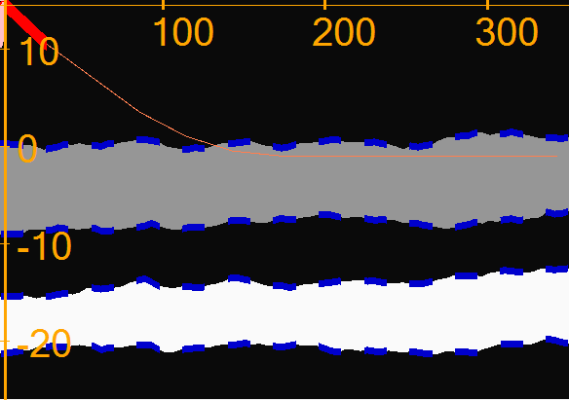

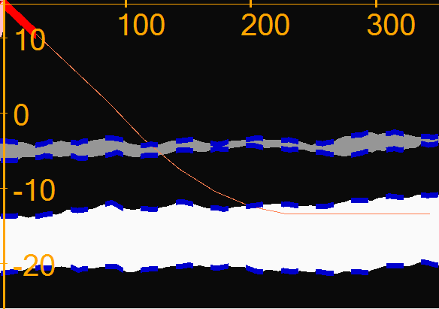

The goal: Maximize the NPV of your well
Scoring. You get:
h points for every meter in sand layer (along X-axis)
2*h points when you stay in sweet spot near the roof
–c points cost of drilling is subtracted for every meter
h
Choose the layer and when to land
h is the layer thickness
sweet spot: 0.5 to 1.5 from the roof
c = 0.086
Notes:
There are 2 layers
It still looks easy
You see the picture. Compute the area of each layer. Drill for max.
What’s the catch

Slide 2
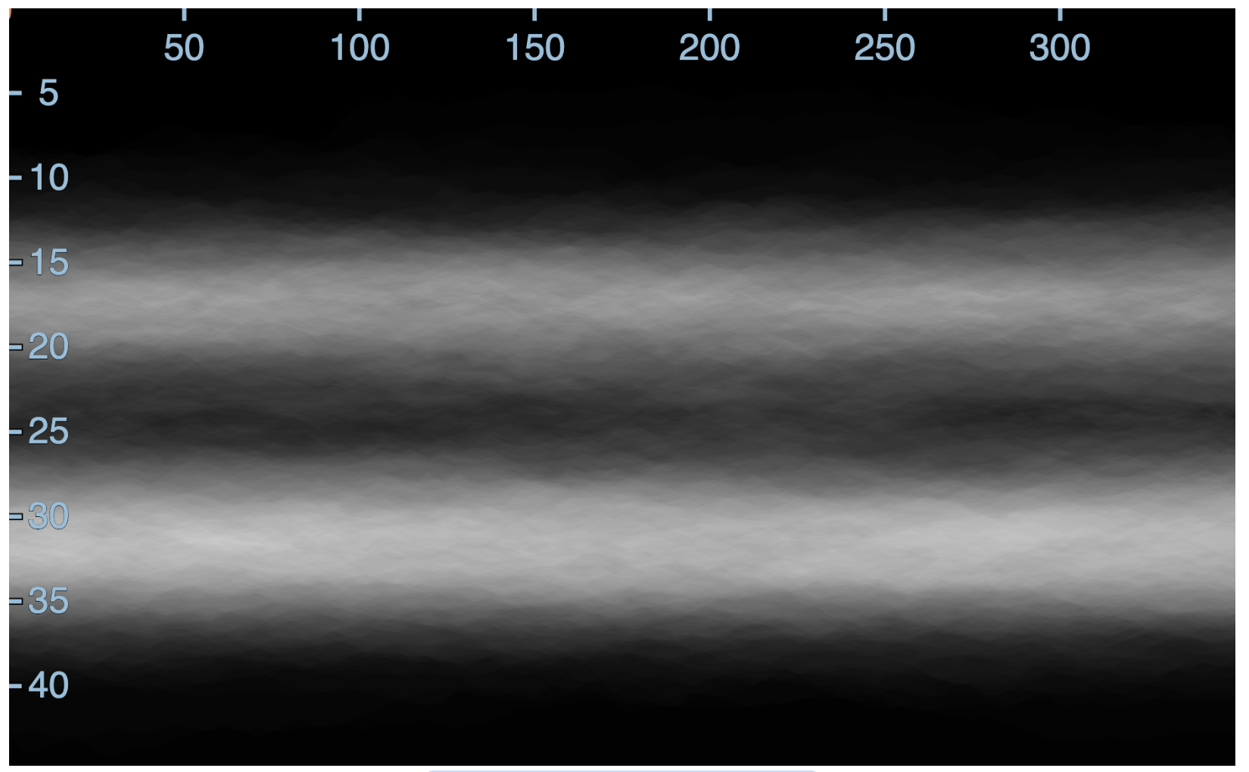
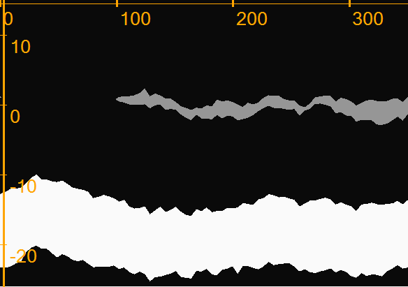
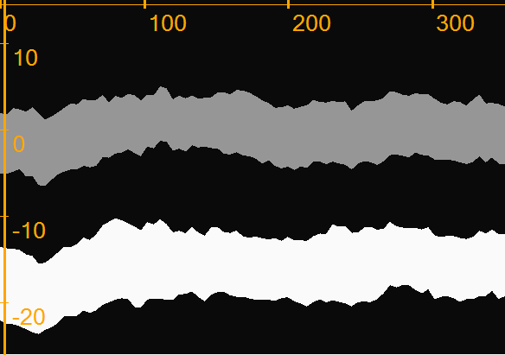
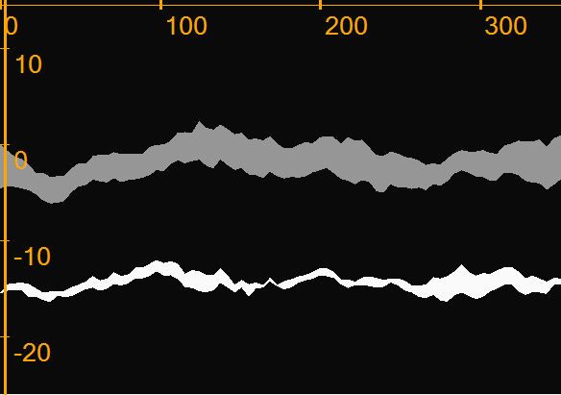
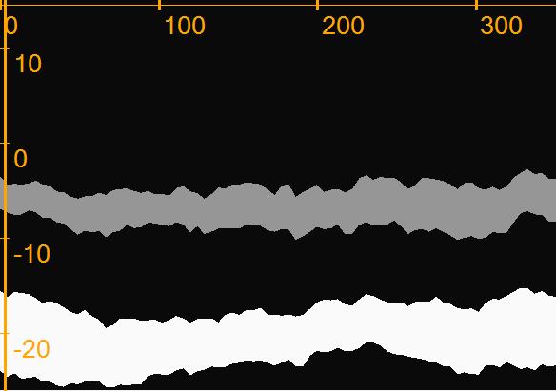
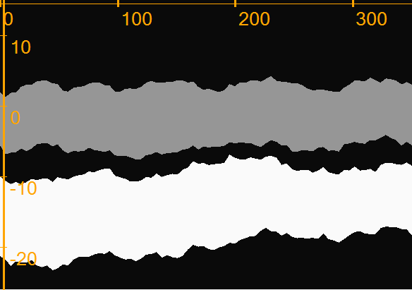
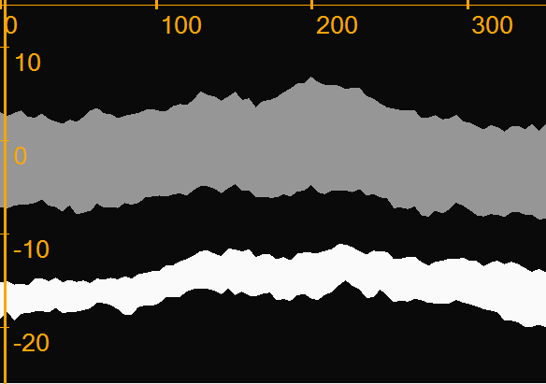
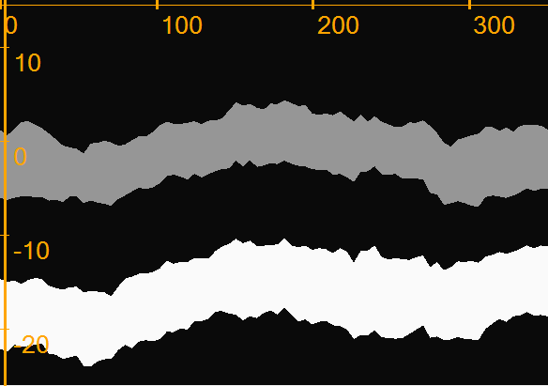
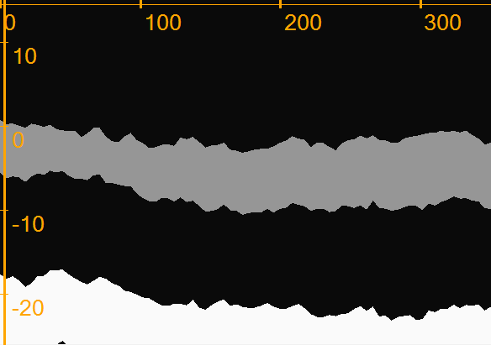
Uncertainty
We represent uncertainty as an ensemble of realizations
Realizations have 2 sand layers
Possible pinch-ins
High contrast
No faults
Overprint of all 120
Notes:
uncertainty gets in the way
The picture is blurry because of the uncertainty
At norce we like to
How to deal with uncertainty?

Slide 3
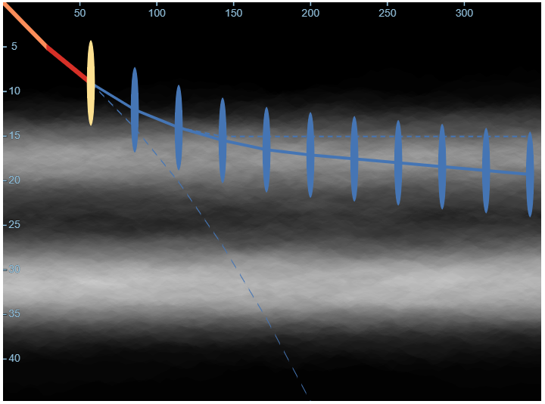


The game consists of turns
Each turn:
You can
Plan ahead and re-plan
You must
Make decision

Slide 4
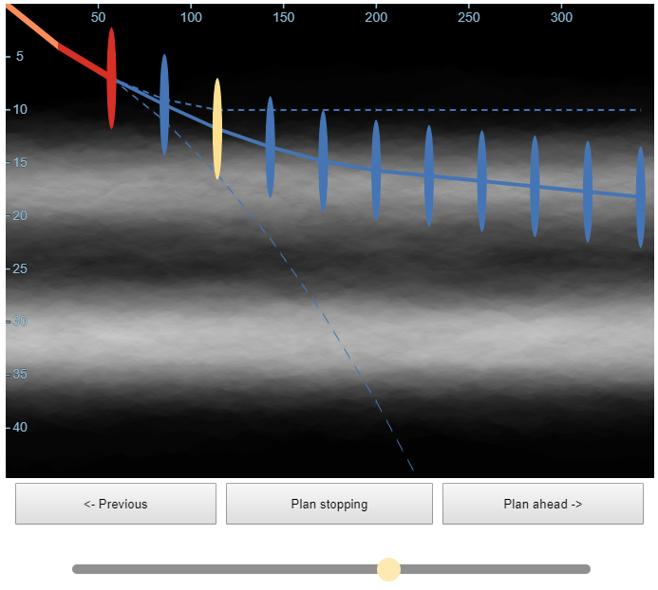
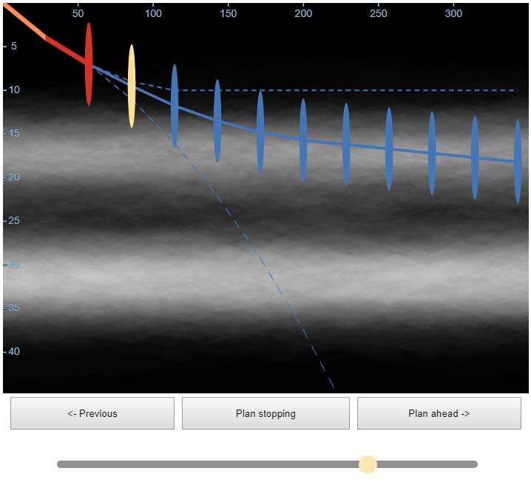

How to plan ahead?
90° is the limit
←→ Move the selection
For selected point
Change dip with Slider
Plan stop if needed with Button
cut the rest of the well
←
→
drop
+/- 2°
build

Slide 5
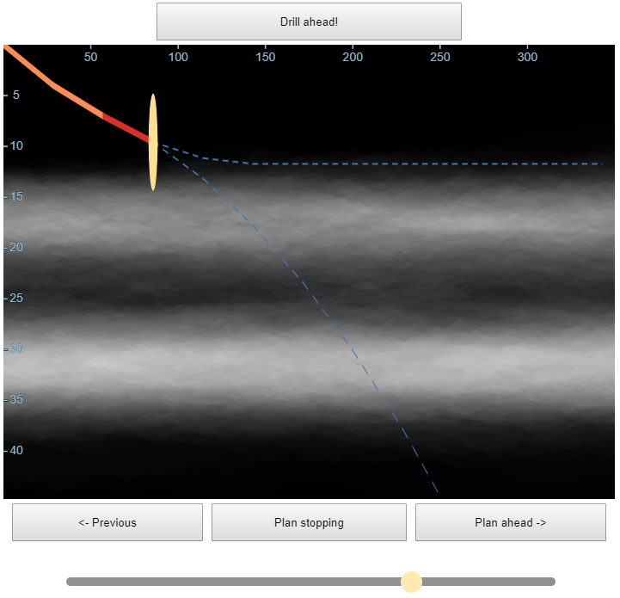
For each turn Make decision
3
direction to drill
to stop
drilling
How?
For next point
Steer with the slider
or
Stop with the button
then
Finalize the decision
or
1
2
2
3
1

Slide 6
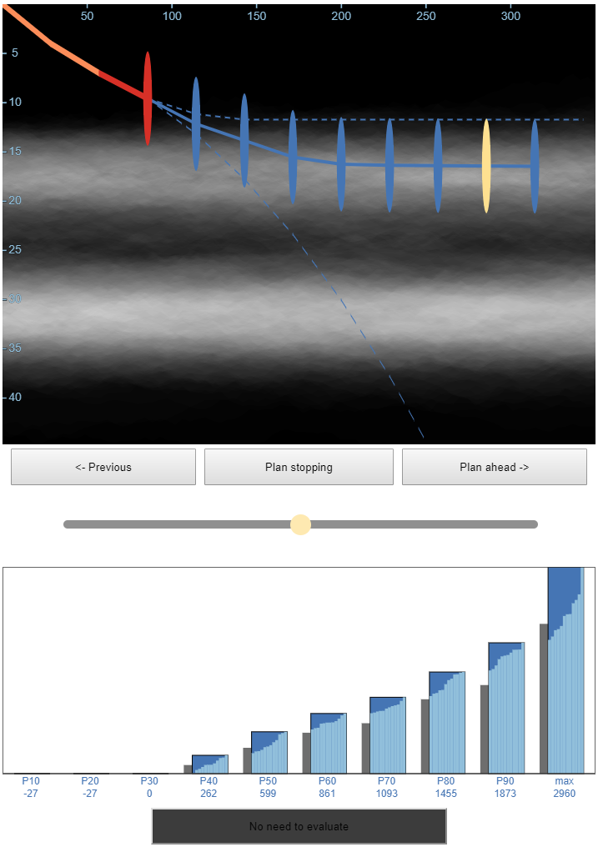
To get the best score make informed decisions
Change your plan ahead
re-plan
Evaluate score
New distribution
Can do better?
Yes
P10
P50
P90
No
! Click a bar to see subset of realizations
Drill / Stop
EVALUATE
Notes:
MEDIAN
You can visually compare with previous
You can select sub-set of realizations

Slide 7
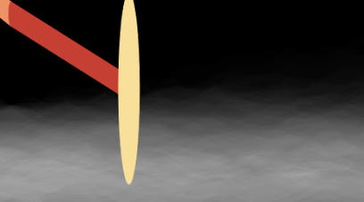
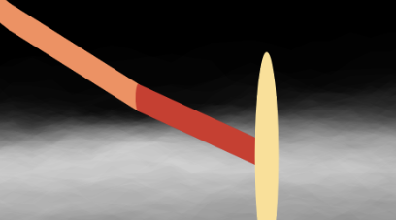
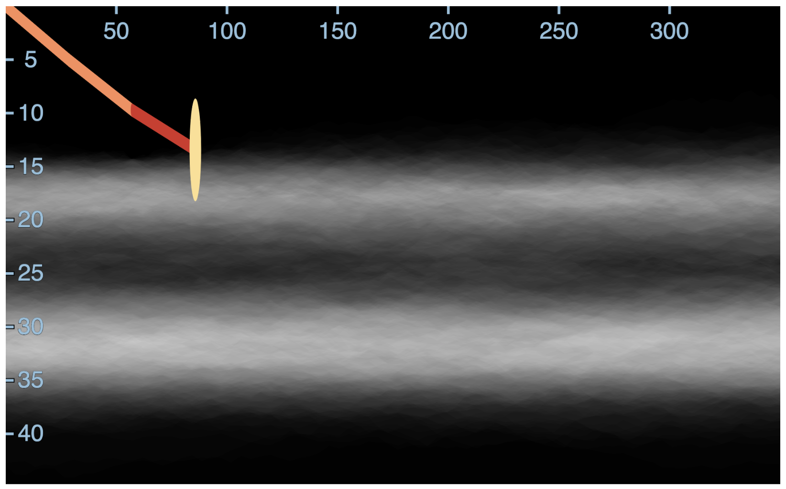
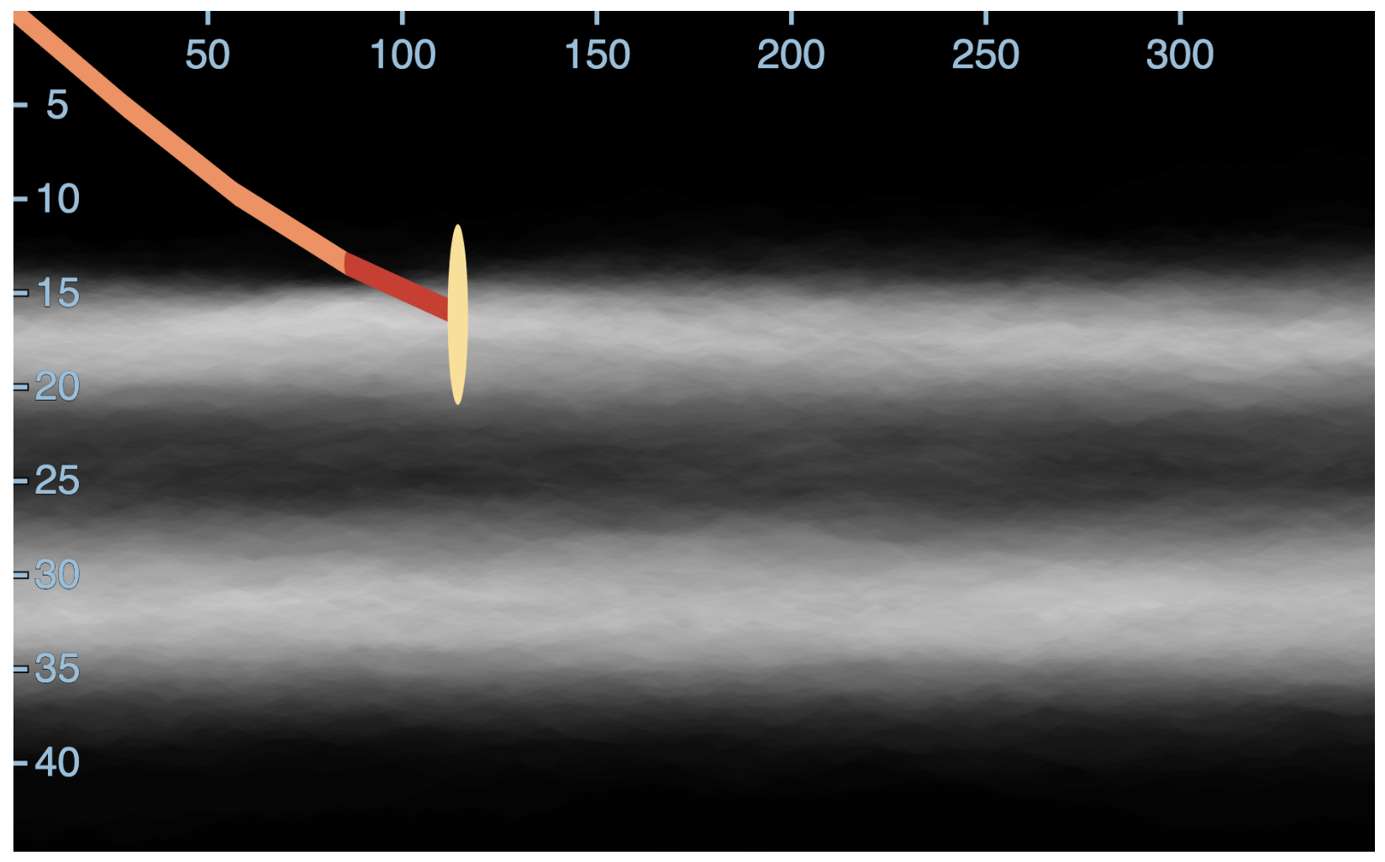
What happens when you drill?
CLEVerEM tool reduces uncertainty
before
after
4.8m
4.8m
after
Located at the bit
Azimuthal sensitivity up to 4.8m
CLEVerEM tool integrates
new data
into model realizations
via a systematic EnKF update
Notes:
Why is it clever?
Each of you will make your own decisions and see your own uncertainty

Slide 8
What happens when you drill?
CLEVerEM tool reduces uncertainty:
before
after
4.8m
4.8m
after
Uncertainty is reduced
Time to take your phone and plan ahead!
Notes:
Why is it clever?
Evryone gets their own tool

Slide 9
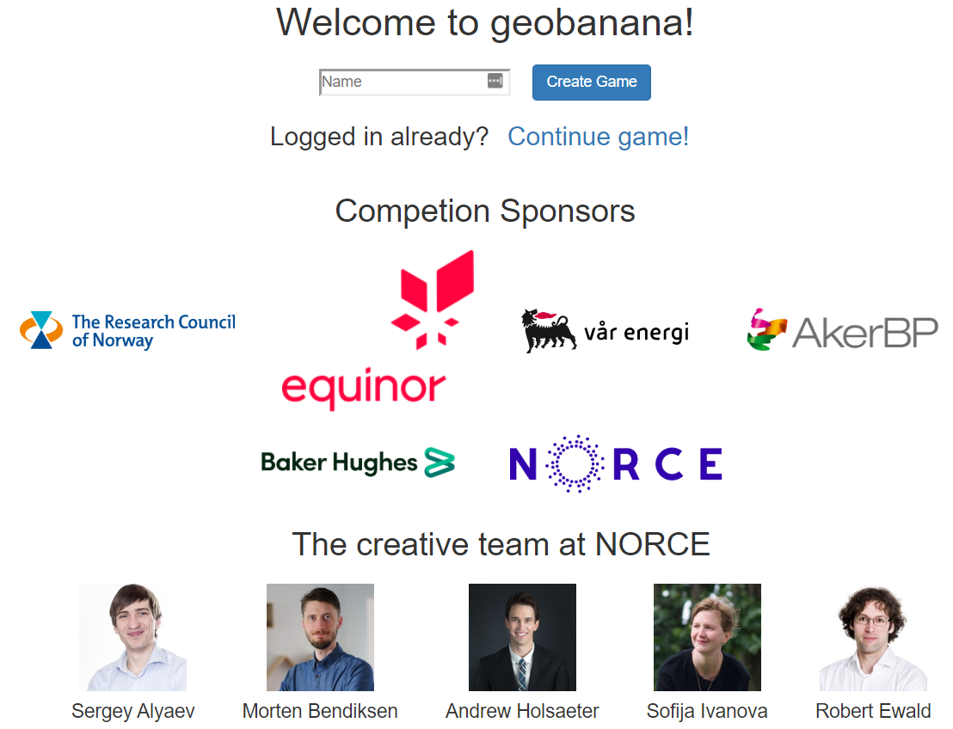
1 test round
3 scoring rounds
The winner gets a trophy
during dinner
Competition sponsors

Slide 10
What happens when you drill?
CLEVerEM tool reduces uncertainty:
4.8m
4.8m
Located at the bit
Azimuthal sensitivity up to 4.8m
CLEVerEM tool integrates
new data
into model realizations
via a systematic EnKF update
Notes:
Црн шы ше сдумук

Slide 11
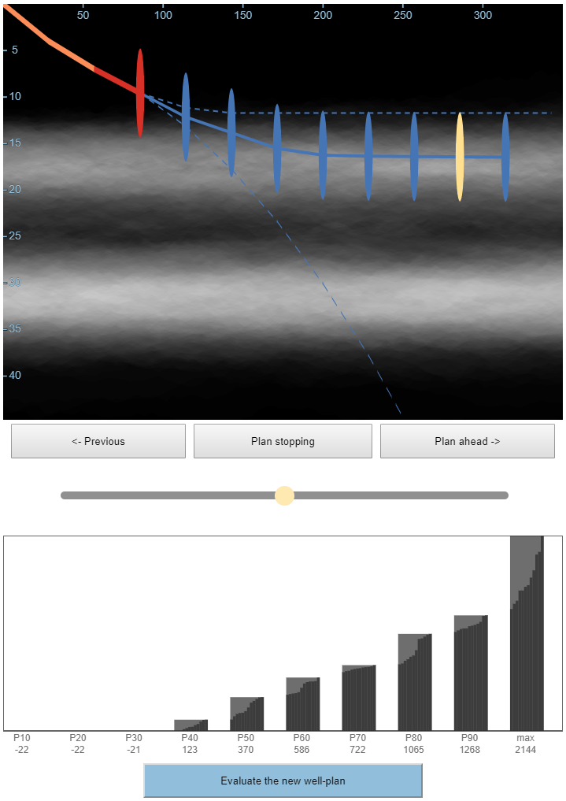
To get the best score make informed decisions
Change your plan ahead

Slide 12
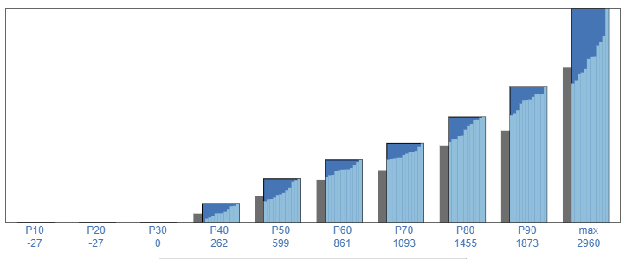
To get the best score make informed decisions
Change your plan ahead
Evaluate score
New distribution

Slide 13
To get the best score make informed decisions
Change your plan ahead
Evaluate score
New distribution
P10
P50
P90
Notes:
P10 MEDIAN P50 P90
You can visually compare with previous
You can select sub-set of realizations

Slide 14
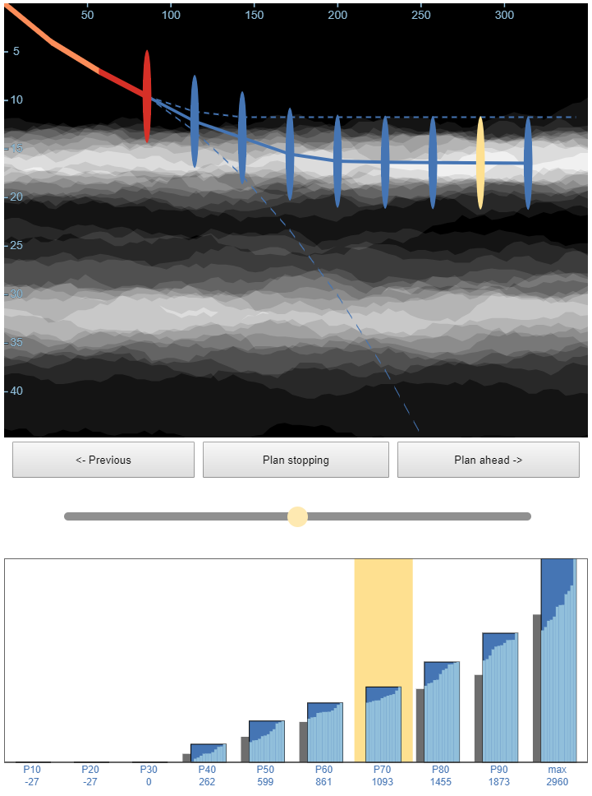
To get the best score make informed decisions
Change your plan ahead
Evaluate score
New distribution
P10
P50
P90
Notes:
You can visually compare with previous
You can select sub-set of realizations

Slide 15
To get the best score make informed decisions
Change your plan ahead
Evaluate score
New distribution
P10
P50
P90
Notes:
You can visually compare with previous
You can select sub-set of realizations

Slide 16
To get the best score make informed decisions
Change your plan ahead
re-plan
Evaluate score
New distribution
Can do better?
P10
P50
P90
Yes
No
Drill / Stop
Notes:
MEDIAN
You can visually compare with previous
You can select sub-set of realizations

